Slide 1

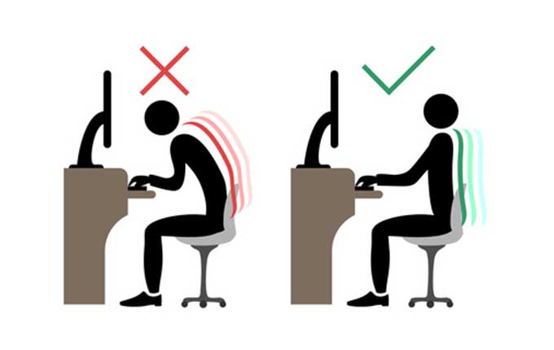

Internet of Things – Project proposal
HEALTHY POSTURE :
CONNECTED CHAIR CUSHION
Etienne Famery
Amandhi Kahawita
Sirine Nouri

Slide 2
Functional Aspect

Slide 3
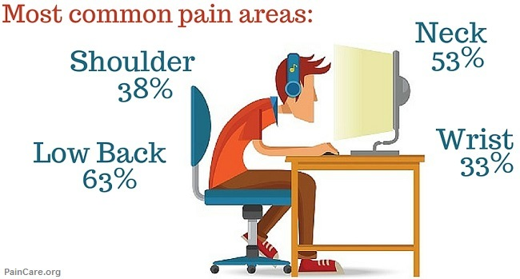
Back pack : the pain of the century
76 % of workers suffer from back pain
71% of teenagers / young adult have back pains

Slide 4
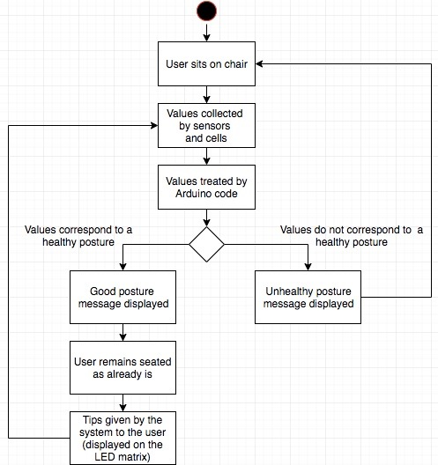
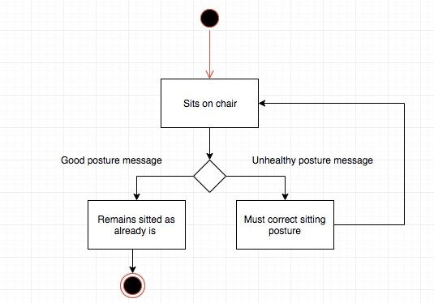
Healthy Posture : a cushion to correct your posture

Slide 5
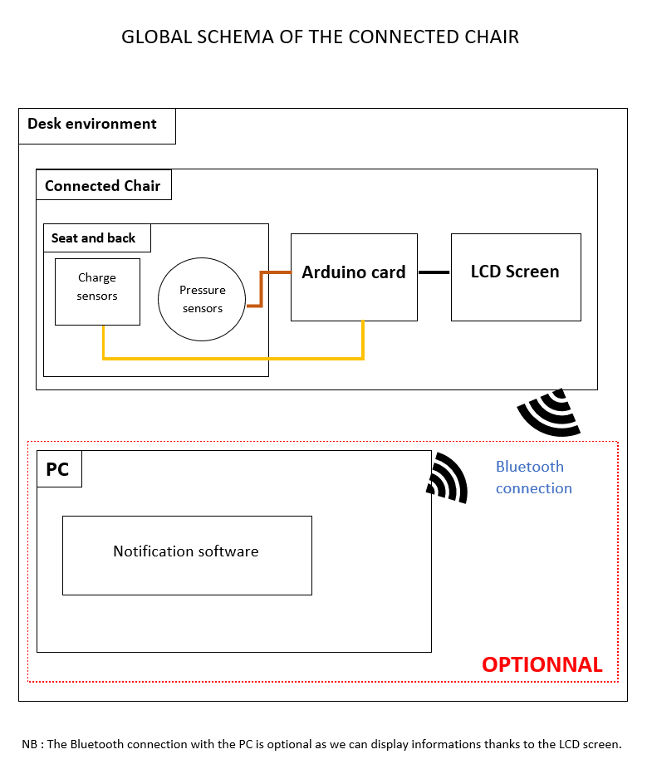
How our system will work

Slide 6



Public targeted

Slide 7
Technical Aspect

Slide 8
Components used
Jumper wires males and females
Resistors ( Ohm value still to be determined)
Force sensor : 2x
Load cells : 2x TEM01052B
Arduino UNO card
ESP32 module
Chair cushion

Slide 9
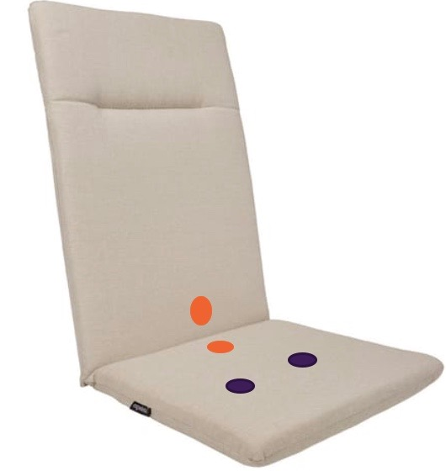
Functional schema
Load cells
Force sensors
Force sensor
Load cells
Force sensors

Slide 10
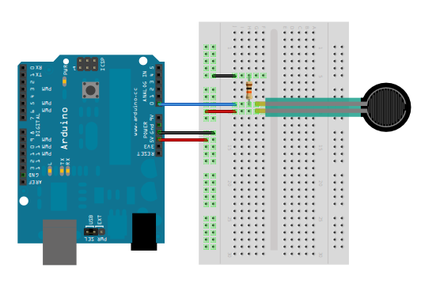
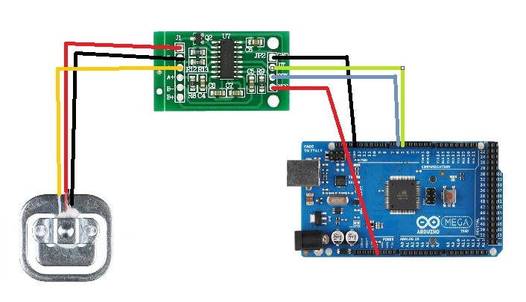
Force sensors & load cells : implementation

Slide 11
User’s behavior on the chair | Chair’s technical analysis | Message displayed on the LCD screen
Case 1: the user applies a homogenous pressure on the seat portion AND rest his/her back correctly on the back of the chair. | The load cells detect both the same range of values AND the force sensors both return a value | “Good healthy posture !”
Case 2: The user applies a homogenous pressure on the seat portion BUT does not correctly rest his/her back on the back of the chair | The load cells detect both the same range of values BUT only one or none of the force sensors return a value | “You’d have an even healthier position while resting your back on the chair”
Case 3: The user rests his/her back on the back of the chair BUT does not apply a homogenous pressure on the seat portion | The force sensors return both a value BUT the load cells do not detect the same range of values | “Wrong posture, try to sit correctly in the center of the seat”
Case 4: The user neither applies a homogenous pressure on the seat portion nor rest his/her back correctly on the back of the chair. | The load cells do not detect the same range of values AND the force sensors do not return a value | “Unhealthy posture! try to sit correctly in the center of the seat and rest your back on the chair”

Slide 12
Thank you for your attention

